Slide 1
Unit: 2 (Machine learning clustering algorithms-II)

Slide 2
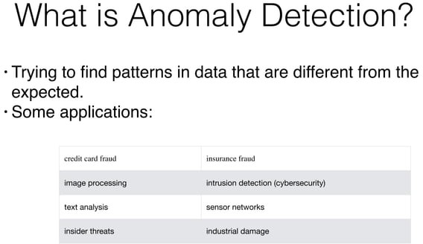
Anomaly detection in machine learning refers to the process of identifying data points or patterns that deviate significantly from the norm or the expected behavior.

Slide 3
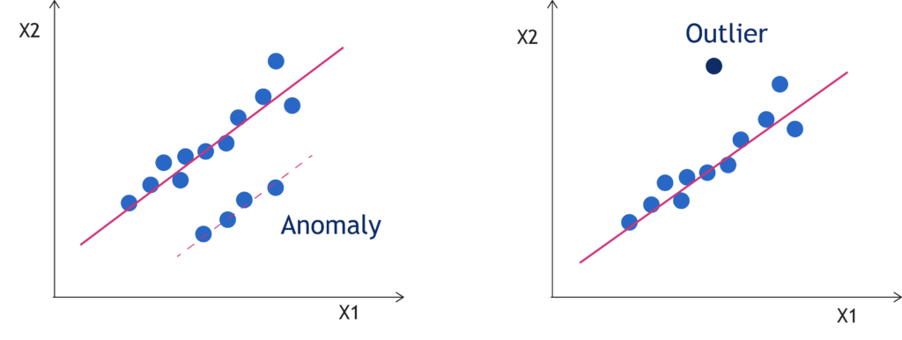

Slide 4


Slide 5
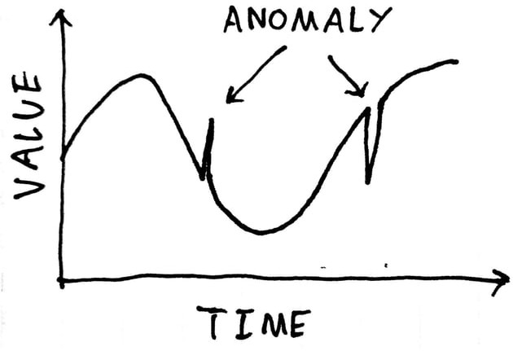

Slide 6
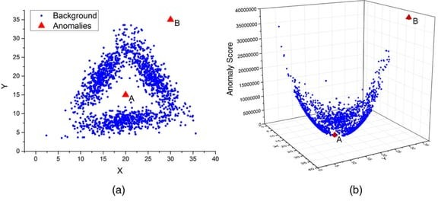

Slide 7
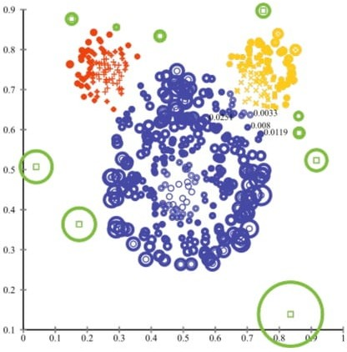

Slide 8
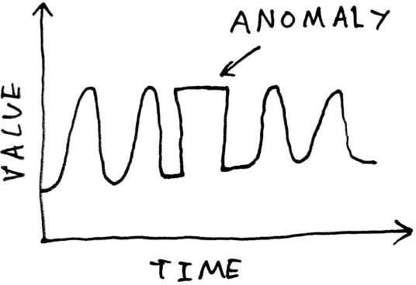

Slide 9
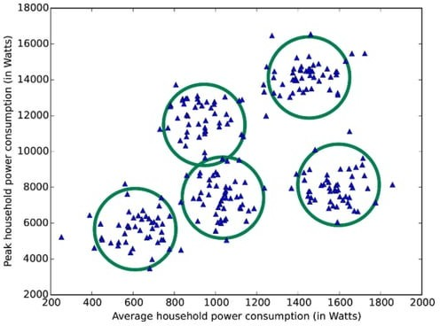

Slide 10
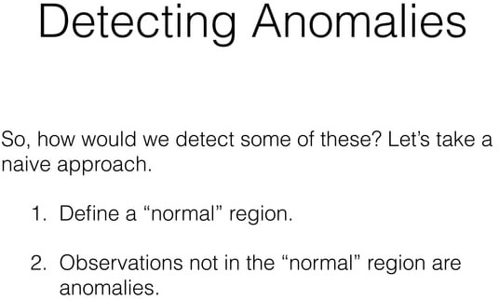

Slide 11
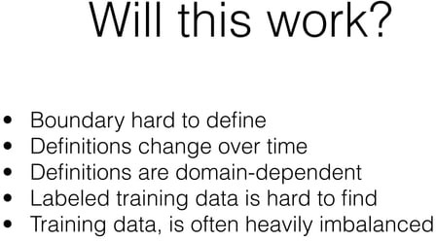

Slide 12
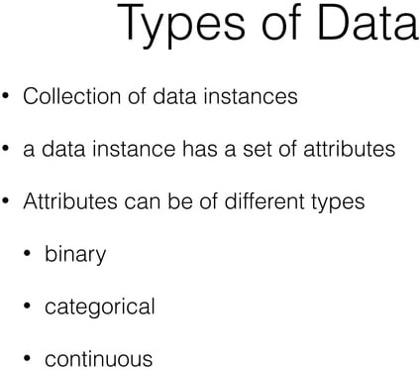

Slide 13
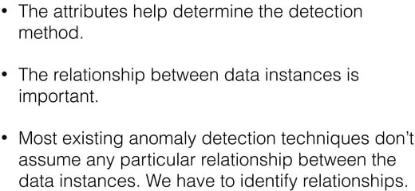

Slide 14
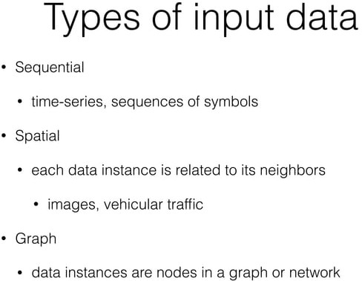

Slide 15
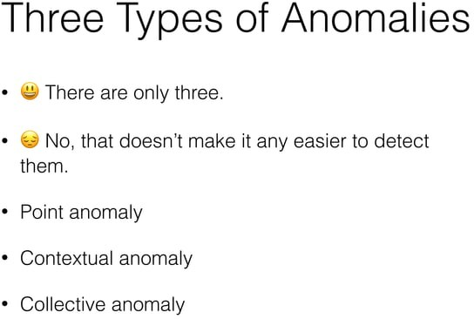

Slide 16
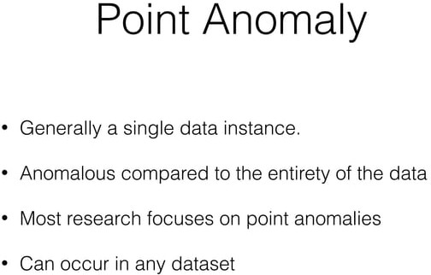
Point anomalies (Outliers), also known as global anomalies, refer to individual data points that deviate significantly from the rest of the data. These anomalies are isolated and stand out from the majority of the data points.
Example: Detecting a fraudulent credit card transaction where the transaction amount is far larger or smaller than the typical spending behaviour of the cardholder.

Slide 17
Point Anomalies (Outliers)
Point anomalies, also known as outliers, are data points that significantly differ from the rest of the dataset. These anomalies can be classified into two subcategories:
Univariate outliers: These are deviations from the norm within a single data set. For example, in a sales database, a customer age of 150 would be considered a univariate outlier. Such anomalies can be easily identified by examining individual data points and comparing them to the expected range or distribution of values within the dataset.
2. Multivariate outliers: These anomalies are identified by considering multiple variables together. For instance, a purchase with an unusually high quantity of a rarely bought item together would be a multivariate outlier. Detecting multivariate outliers requires a more complex analysis that takes into account the relationships and correlations between different variables.

Slide 18
Point Anomalies (Outliers)
Point anomalies can be identified using various statistical methods and visualization techniques:
Z-scores: By calculating standard deviations, outliers that fall outside a specific range (e.g., 3 standard deviations from the mean) can be identified. This method is particularly useful for identifying univariate outliers and helps in understanding the extent to which a data point deviates from the norm.
Interquartile Range (IQR): IQR defines the range of typical values and helps identify outliers beyond the upper or lower quartile boundaries. This technique is robust to extreme values and provides a non-parametric approach to outlier detection.
Boxplots: These visualizations represent the distribution of data, with outliers appearing as data points outside the box whiskers. Boxplots offer a quick and intuitive way to identify outliers and understand the overall distribution of the dataset.
Scatterplots: Scatterplots can reveal unusual patterns or clusters that might indicate outliers, especially in multivariate analysis. By plotting different variables against each other, scatterplots help in identifying data points that deviate from the expected relationships or trends.

Slide 19
Contextual Anomalies
Contextual anomalies, also called conditional anomalies, are data points that are considered anomalous only within a specific context or condition. These anomalies might be normal in one context but abnormal in another.
Example: An increase in web traffic on a retail website during holiday seasons might not be anomalous, but the same traffic increase on a different website not related to retail during the same time could be considered anomalous.

Slide 20
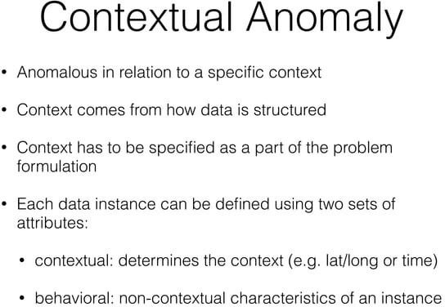

Slide 21
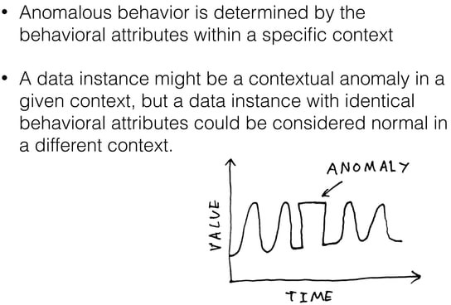

Slide 22
Behavioral Anomalies
Behavioral anomalies refer to deviations from expected patterns or norms in the behavior of a system, entity, or individual.
These anomalies are identified based on the behavior of the data or process over time or across different scenarios.
Behavioral anomalies are often used in contexts like fraud detection, user behavior analytics, or network security, where the focus is on detecting unusual activities based on historical patterns.
Example: In network security, a behavioral anomaly might be detected if an employee who typically logs in during business hours suddenly starts logging in at odd hours or from unusual locations. This deviation from their typical behavior could indicate a security breach or compromised credentials.

Slide 23
Contextual Anomalies:
Contextual anomalies are data points that are considered anomalous only when evaluated within a specific context.
Unlike behavioral anomalies, which are more about deviations from general patterns, contextual anomalies depend heavily on the surrounding environment or context, which is defined by specific attributes such as time, location, or conditions.
Example: Consider the temperature in a server room. A temperature of 25°C might be normal during the day but anomalous at night when the expected temperature should be lower. The context here is the time of day, making 25°C a contextual anomaly during the night.
Key Differences: Behavioral anomalies focus on deviations from expected behavior over time or scenarios, without necessarily depending on the context. Contextual anomalies are dependent on the specific context or conditions, meaning a data point might only be considered anomalous when viewed within that particular context.

Slide 24
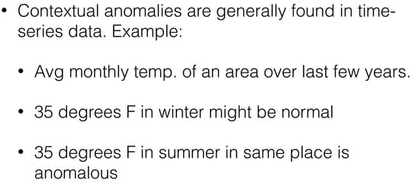

Slide 25
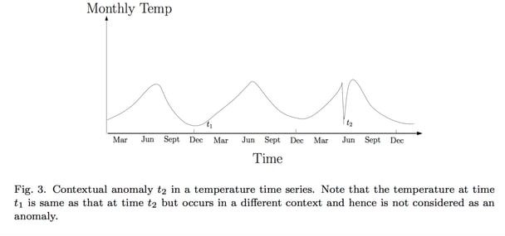

Slide 26
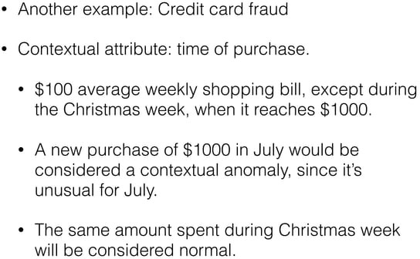

Slide 27
Collective Anomalies
Collective anomalies, also known as group anomalies or cluster-level anomalies, involve a group or a subset of data instances that collectively exhibit anomalous behavior when considered together. Individually, the data points might appear normal, but their combination is abnormal.
Example: Identifying a cluster of network devices that exhibit unusual communication patterns compared to the overall network traffic. While each device's behavior might appear normal on its own, the collective behavior of the devices as a group is anomalous.

Slide 28
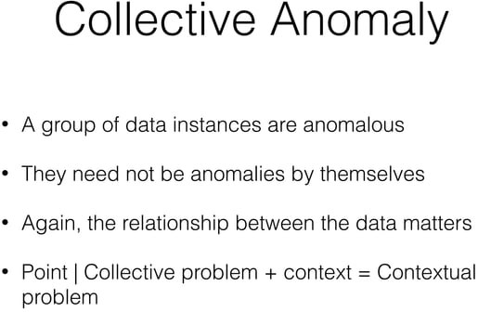

Slide 29


Slide 30
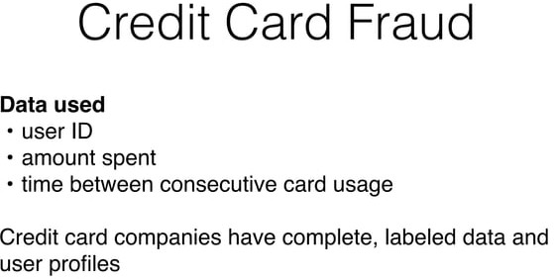

Slide 31
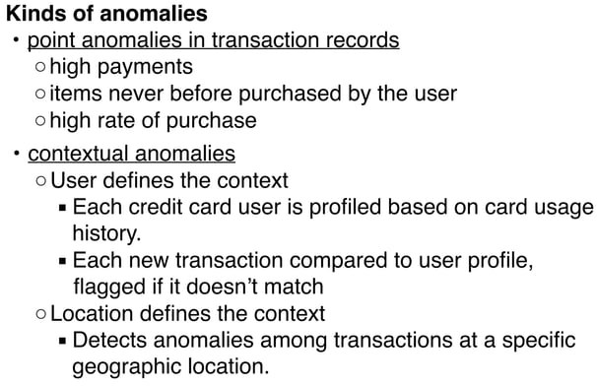

Slide 32
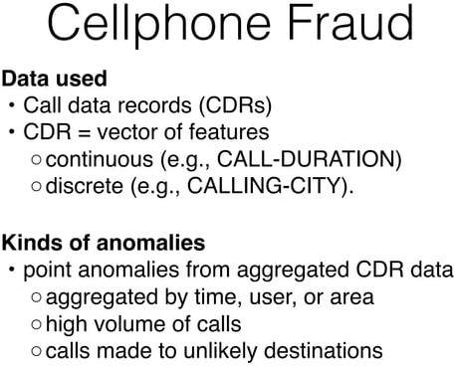

Slide 33
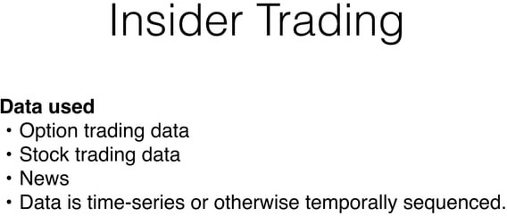

Slide 34
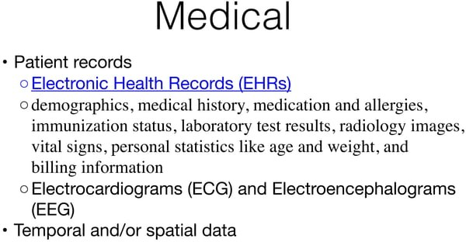

Slide 35
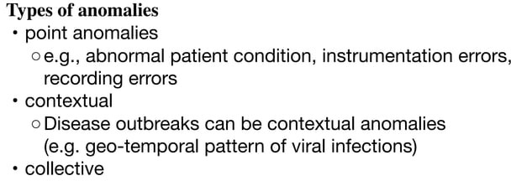

Slide 36
Advantages of Anomaly Detection
Early Detection: Anomaly detection can identify unusual patterns or observations in data at an early stage, allowing for early intervention and prevention of potential issues.
Automation: Anomaly detection can be automated, allowing for continuous data monitoring and reducing the need for manual intervention.
Scalability: Anomaly detection can be applied to large datasets, making it suitable for big data applications.
Adaptability: Anomaly detection can be applied to various data types, including numerical data, time series data, and categorical data.
Real-time Monitoring: Anomaly detection can be used for real-time data monitoring, allowing for immediate action in case of an anomaly.

Slide 37
Limitations of Anomaly Detection
Data Quality: Anomaly detection’s performance depends on the data’s quality. Poor quality data can result in false positives or false negatives.
Choice of Algorithm: The choice of algorithm can also affect anomaly detection performance. Some algorithms may be better suited for certain types of data or specific use cases.
The threshold for Determining Anomalies: The threshold for determining anomalies is subjective and can affect anomaly detection performance.
The imbalance between Normal and Anomalous Data: As anomalous data is typically rare, it can be challenging to train a model that can accurately identify them. This is known as the class imbalance problem.

Slide 38
Anomaly Detection Vs Supervised Learning
Supervised learning excels with labeled data, offering clear classification of both normal and anomalous data points.
Anomaly detection works well with unlabeled data, identifying deviations from the learned normal behavior.

Slide 39
Anomaly Detection using Decision Tree
import numpy as np
import matplotlib.pyplot as plt
from sklearn.tree import DecisionTreeClassifier
from sklearn.model_selection import train_test_split
from sklearn.metrics import confusion_matrix
# Generate synthetic data
np.random.seed(42)
normal_data = np.random.randn(1000, 2) * 2 # Normal data points
anomaly_data = np.random.randn(50, 2) * 10 # Anomaly data points
# Create labels (0 for normal, 1 for anomalies)
labels = np.zeros(normal_data.shape[0])
anomaly_labels = np.ones(anomaly_data.shape[0])
labels = np.concatenate((labels, anomaly_labels))
# Combine normal and anomaly data
data = np.vstack((normal_data, anomaly_data))

Slide 40
# Split data into training and testing sets
X_train, X_test, y_train, y_test = train_test_split(data, labels, test_size=0.2, random_state=42)
# Fit Decision Tree model
model = DecisionTreeClassifier(random_state=42)
model.fit(X_train, y_train)
# Predict anomalies
predictions = model.predict(X_test)
# Evaluate model performance
conf_matrix = confusion_matrix(y_test, predictions)
print("Confusion Matrix:")
print(conf_matrix)
# Plot the data and decision boundary
plt.scatter(X_test[:, 0], X_test[:, 1], c=predictions, cmap=plt.cm.Paired)
plt.title("Anomaly Detection using Decision Tree")
plt.xlabel("Feature 1")
plt.ylabel("Feature 2")
plt.show()

Slide 41
Program for Anomaly Detection using KMeans
# Fit K-Means model
num_clusters = 5
model = KMeans(n_clusters=num_clusters)
model.fit(data)
# Assign data points to clusters
cluster_labels = model.labels_
# Calculate cluster sizes
cluster_sizes = np.bincount(cluster_labels)
import numpy as np
import matplotlib.pyplot as plt
from sklearn.cluster import KMeans
# Generate synthetic data
np.random.seed=42
normal_data = np.random.randn(1000, 2) * 2 # Normal data points
anomaly_data = np.random.randn(50, 2) * 10 # Anomaly data points
# Combine normal and anomaly data
data = np.vstack((normal_data, anomaly_data))

Slide 42
# Define a threshold for cluster size to identify potential anomalies
anomaly_threshold = np.percentile(cluster_sizes, 5) # 5th percentile cluster size
# Identify potential anomalies
potential_anomalies = data[cluster_labels[np.where(cluster_sizes <= anomaly_threshold)]]
# Plot the data and potential anomalies
plt.scatter(data[:, 0], data[:, 1], c='blue', label='Normal Data')
plt.scatter(potential_anomalies[:, 0], potential_anomalies[:, 1], c='red', label='Potential Anomalies')
plt.legend()
plt.title("Anomaly Detection using K-Means")
plt.xlabel("Feature 1")
plt.ylabel("Feature 2")
plt.show()

Slide 43
Apply anomaly detection algorithm using KMeans clustering on make_blobs dataset. Use threshold as 4th percentile of the cluster size.

Slide 44
Star Course Activity
Make 3 teams of students present in the class.
Allocate any one type of Anomaly to each group.
Ask them to discuss different examples associated with the anomaly allocated to their team.
The team members will share their views with the whole class.

Slide 45
Gaussian Distribution
The Gaussian distribution, also known as the normal distribution. It is a key concept used to model the distribution of real-valued random variables and is essential for understanding various statistical methods and algorithms.
It is a continuous probability distribution function that is symmetrical at the mean, and the majority of data falls within one standard deviation of the mean. It is characterized by its bell-shaped curve.

Slide 46
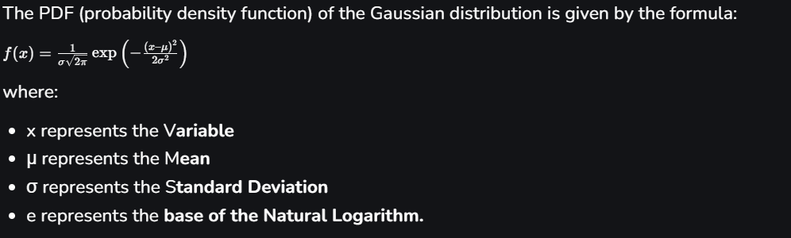
Gaussian Distribution Formula

Slide 47
Gaussian Distribution Curve
The curve is symmetric and bell-shaped, and it mathematically represents the probability distribution of a continuous random variable. The Gaussian distribution is characterized by two parameters: the mean (μ) and the standard deviation (σ), which determine the location and the spread of the curve.

Slide 48
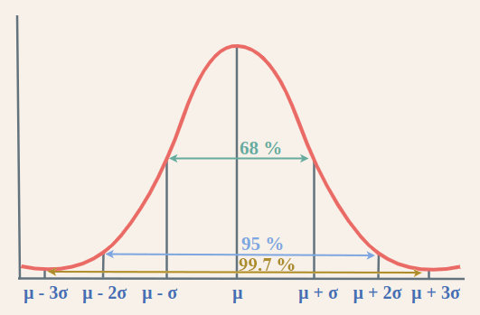
Within one standard deviation of the mean (Mean ± 1 SD), approximately 68% of the data is expected to fall.
Within two standard deviations of the mean (Mean ± 2 SD), approximately 95% of the data is expected to fall.
Within three standard deviations of the mean (Mean ± 3 SD), approximately 99.7% of the data is expected to fall.

Slide 49
The standard deviations are used to subdivide the area under the normal curve. Each subdivided section defines the percentage of data, which falls into the specific region of a graph.
Analysis : A smaller standard deviation results in a narrower and taller bell curve, indicating that data points are clustered closely around the mean. Conversely, a larger standard deviation leads to a wider and shorter bell curve, suggesting that data points are more spread out from the mean.
The Empirical Rule, also known as the 68-95-99.7 rule, quantifies the proportion of data falling within certain intervals around the mean in a normal distribution.

Slide 50
Gaussian Distribution Table
A Gaussian distribution table, also known as a standard normal distribution table or z-table, is a tabulated form that provides values of the cumulative distribution function (CDF) for the standard normal distribution.
The standard normal distribution has a mean(central value) of 0 and a standard deviation of 1.
Normally , the table consists of two columns namely Z-value and their Cumulative probability . Z-value is the number of standard deviations away from the mean. It ranges from negative infinity to positive infinity.
Cumulative probability represents the probability that a standard normal random variable is less than or equal to the corresponding z-value.

Slide 51
Gaussian Distribution Anomaly Detection Algorithm:
Let us consider that there are m data-points (instances) each with n selected features.
The Mean parameter for each feature (j = 1 to n) is fit.
The Variance parameter for each feature (j = 1 to n) is fit.
Given a new data-point, x = {x_1, x_2, … , x_j}, p(x) is given by,
or,
Now, a threshold parameter, ε is selected such that,
if p(x) < ε: # x is an ANOMALY or OUTLIER !!!! else: # x is NOT an ANOMALY or OUTLIER !!!!

Slide 52
Thank you!

